Slide 1

San Diego INCOSE Tutorial: Open Source System Modeling June 10, 2023
Dr. Raymond Madachy Naval Postgraduate School Dept. of Systems Engineering rjmadach@nps.edu
Notes:
Examples throughout of eating one’s own dog food, using PyML to model and explain PyML

Slide 2
Acknowledgments
This research is supported by:
Boehm Center for Systems and Software Engineering
Naval Postgraduate School Foundation for Open Source System Modeling Library research seed project
Marine Corps Air Station (MCAS) Miramar for Optimize the Military and Civilian Workforce with Respect to both Cost and Readiness research project
The following NPS faculty and students have provided critical feature suggestions and testing support:
Ryan Longshore
Dr. John (Mike) Green
Nora Aftel
Patricia Gomez
Notes:
Complete and vet

Slide 3
Systems Engineering Library (se-lib) Goals
Lower access barrier to system modeling with open-source tool environment
Harness power of extensive Python scientific computing and utility libraries (bootstrap don’t reinvent)
Provide integrated capabilities for systems modeling, analysis, documentation and code generation
SysML, other SE model types and analysis methods
Be digital engineering compliant with single source of truth across model set
Compatibility of everything on desktop OS’s and in cloud
Notes:
Harness power of extensive Python scientific computing and utility libraries (bootstrap don’t reinvent)
Increase modeling efficiency and sophistication
Model-driven engineering capability to generate system code (future)

Slide 4
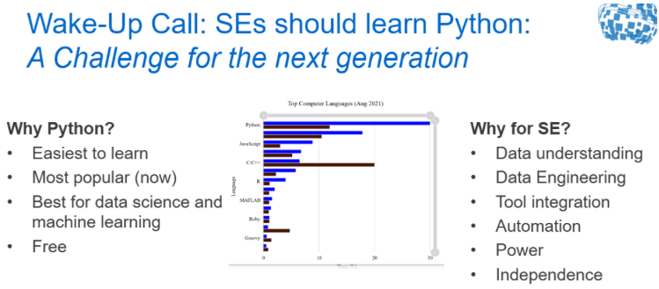
SE Wake-Up Call
Source: Dr. Barclay Brown, INCOSE CIO, INCOSE International Workshop, Torrance, CA, 2023

Slide 5
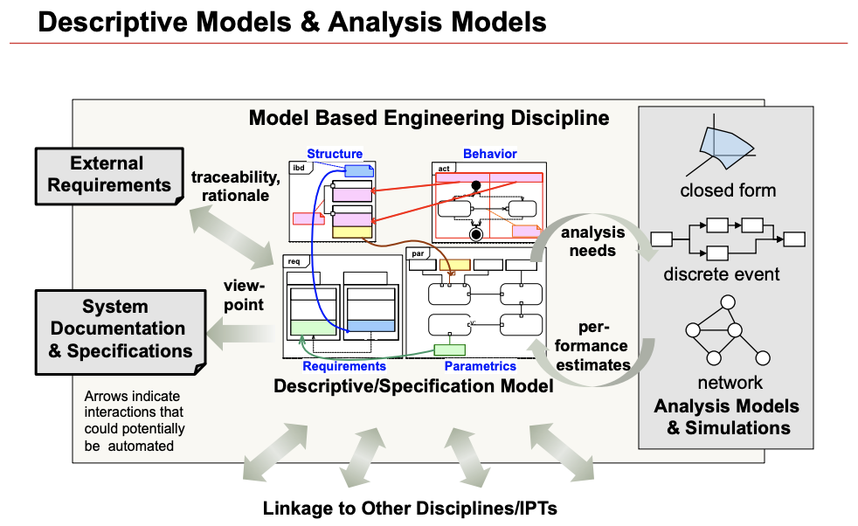
Meeting the Automation Challenge
Source: Rick Steiner, SysML Conceptual Stumbling Blocks, INCOSE San Diego Mini-Conference, January 11, 2013

Slide 6
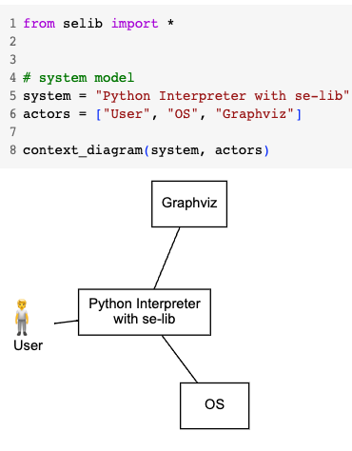
General Usage Features
Use Python for modeling to intersperse model data, system analysis and documentation
Model data can be inline code, read from or to external files
Round-trip engineering to support rapid iterative development
Change a model element and all others affected are automatically updated to maintain consistency across model set
Automatic document re-generation with all changes
Inherent configuration management automation
All artifacts for a project can be developed and controlled with standard version control system such as GitHub for small to large teams.
All models, diagrams, and simulations are specified in text files supporting standard tools for version differencing and reconciliation.
Notes:
e.g. proven on agile projects and devsecops on GitHub
Code at 175%

Slide 7
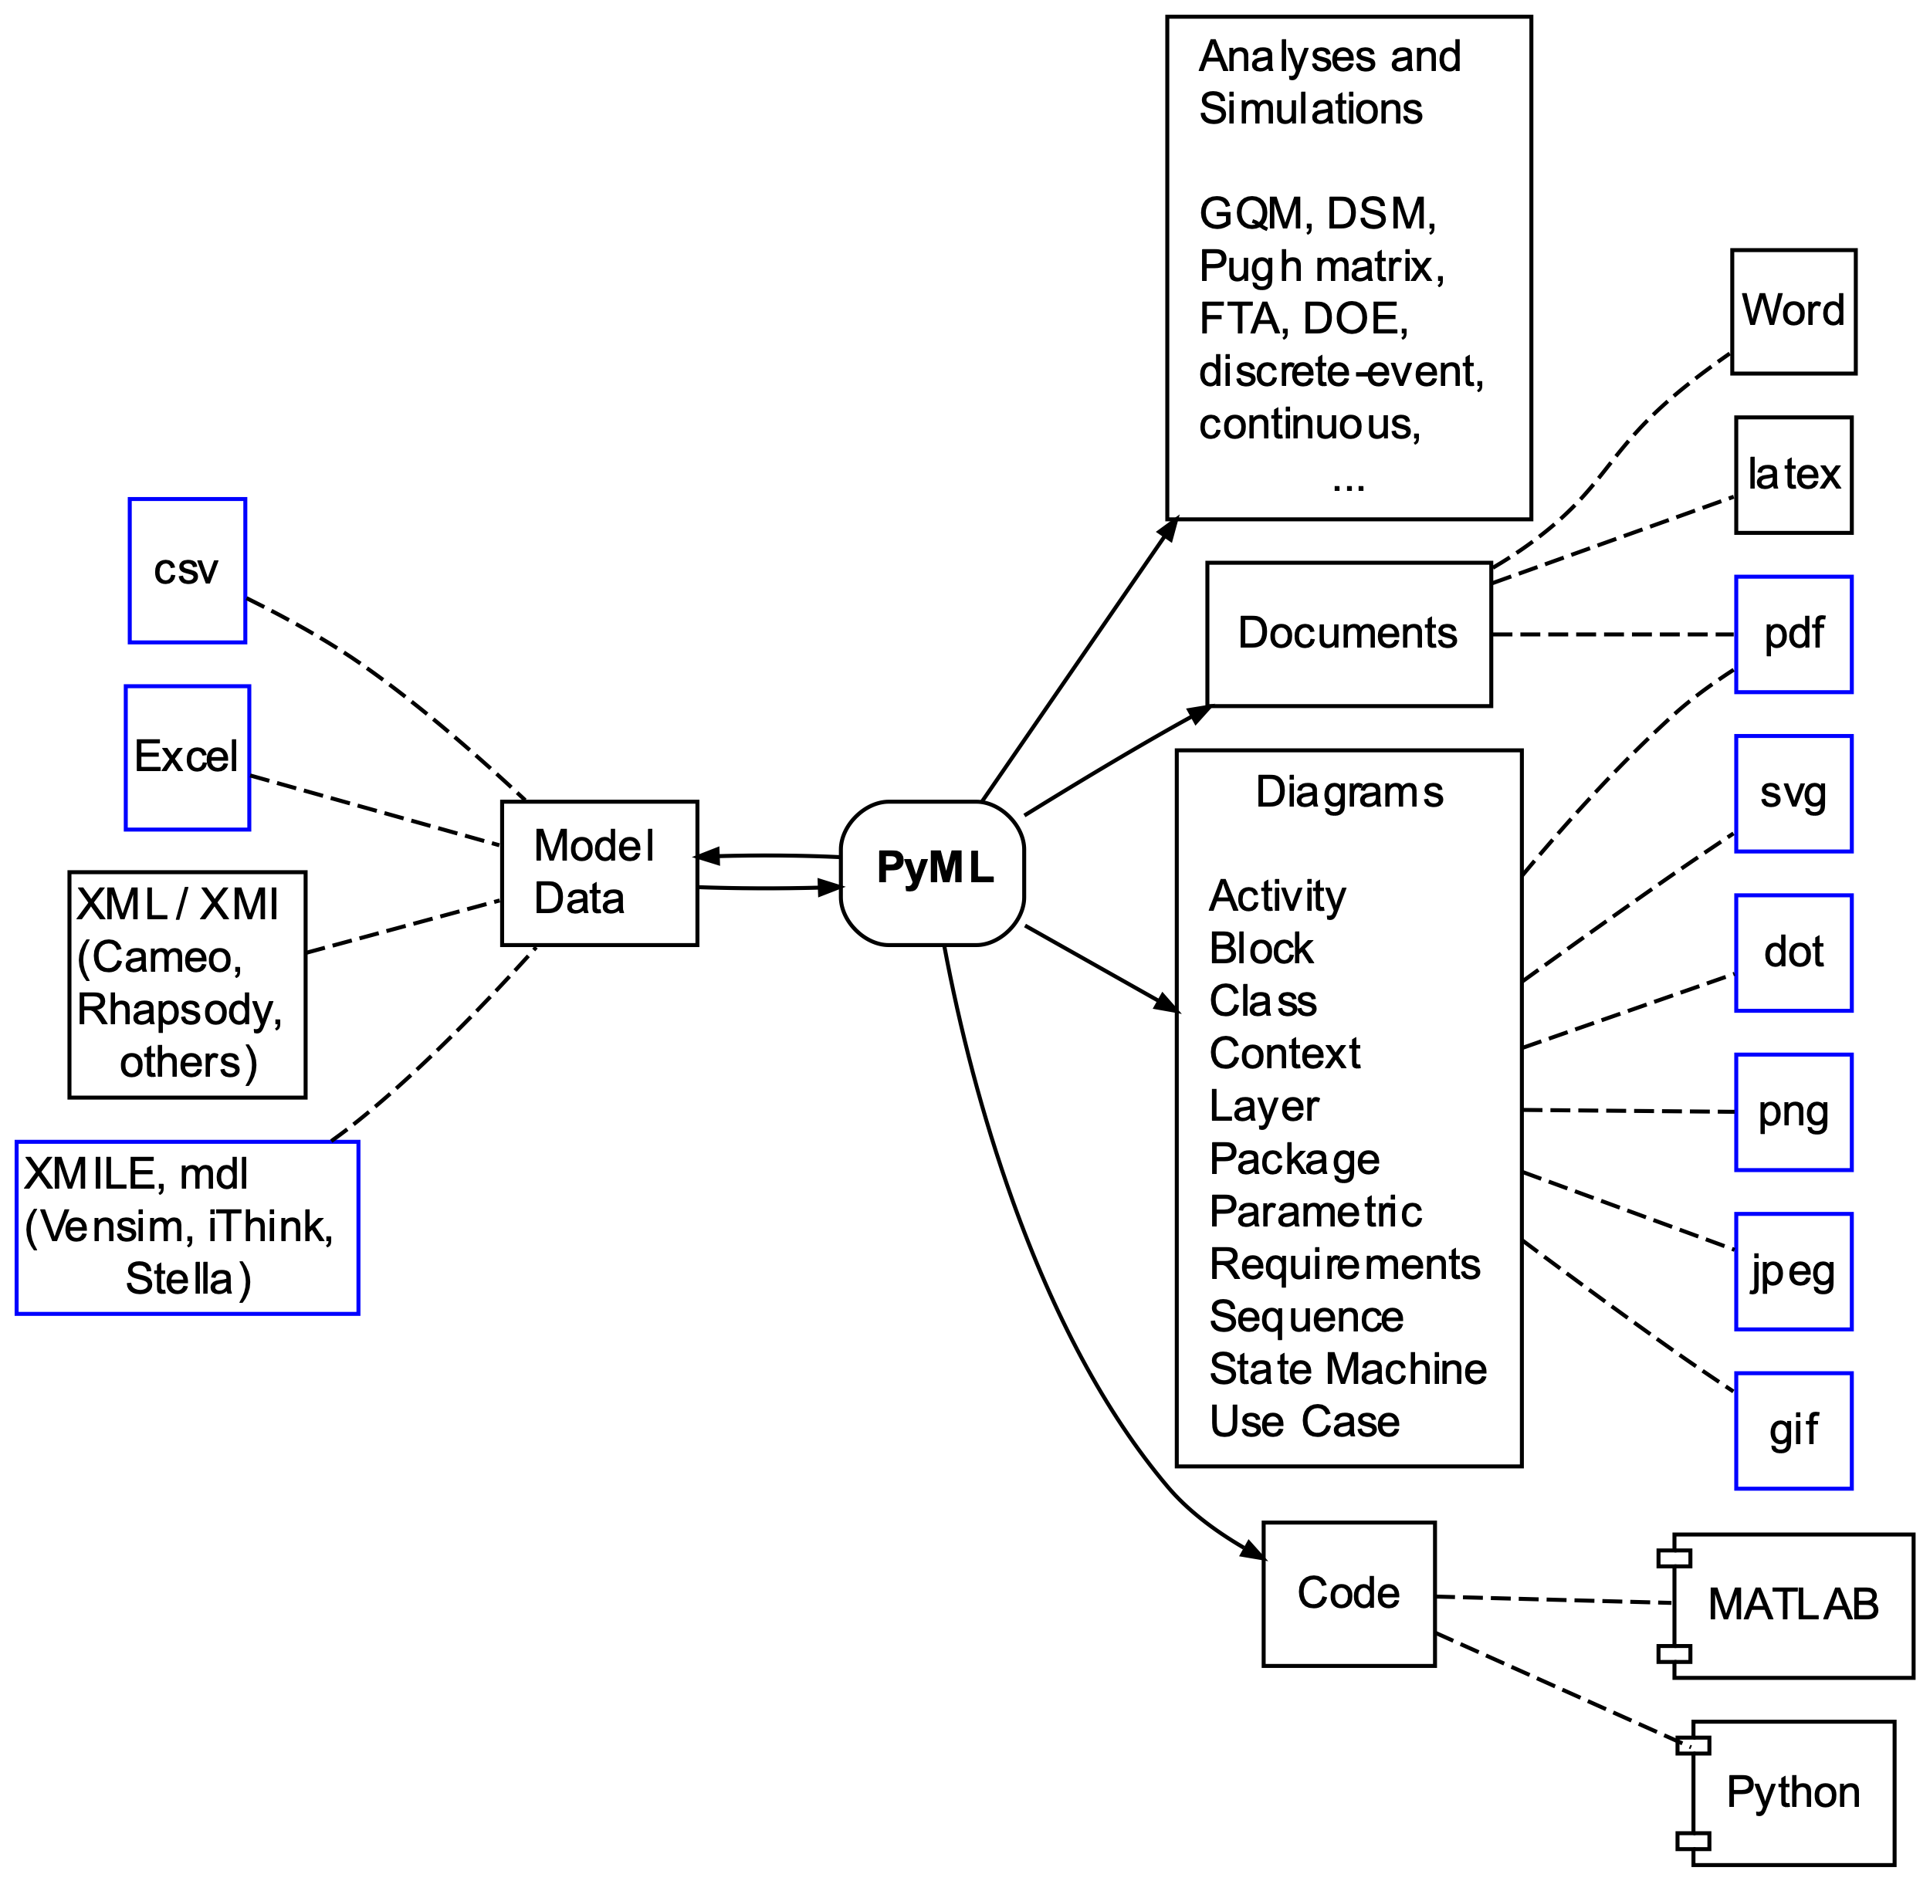
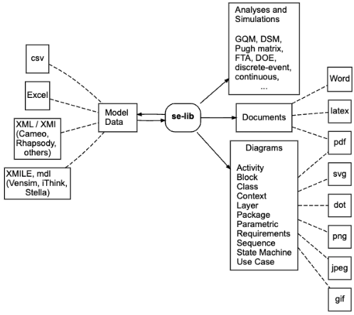
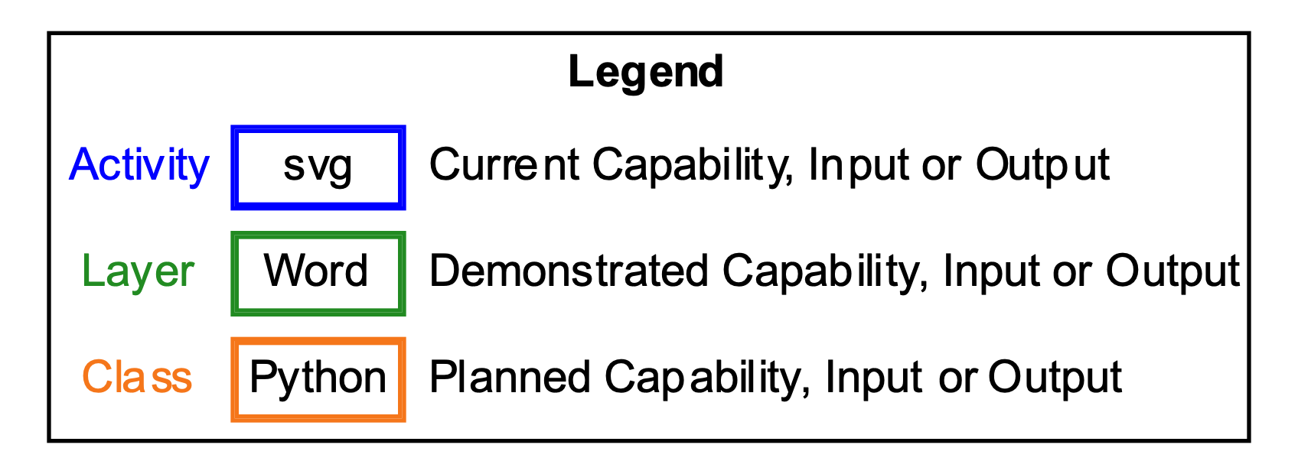
Inputs and Outputs
Notes:
https://tinyurl.com/3e7bep76
Color code for current implementation, partial, demonstrated,
Add legend
Widen

Slide 8
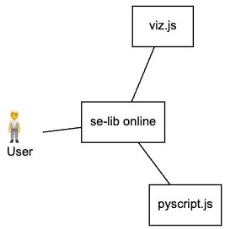
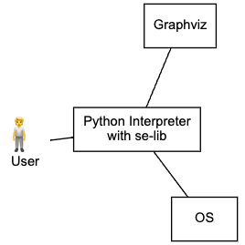
se-lib Context and Architecture
Desktop usage requires Python version 3.8 or higher.
Built on top of open-source:
Graphviz is required to generate diagrams.
The Matplotlib package is required for graphical plots.
NumPy numerical computing package is used for model analysis and some plotting features.
SciPy is a scientific computing library
SimPy is a discrete event simulation framework
PySD with Pandas for the system dynamics simulation engine
pdflatex optionally required to compile latex files and generate pdfs
Offline Online Playground
Desktop Layers
Notes:
Font, to-be, cloud-based
Show online arch.
Update layers
Layered architecture with Python libraries and optional system executables.
Could show code of context

Slide 9
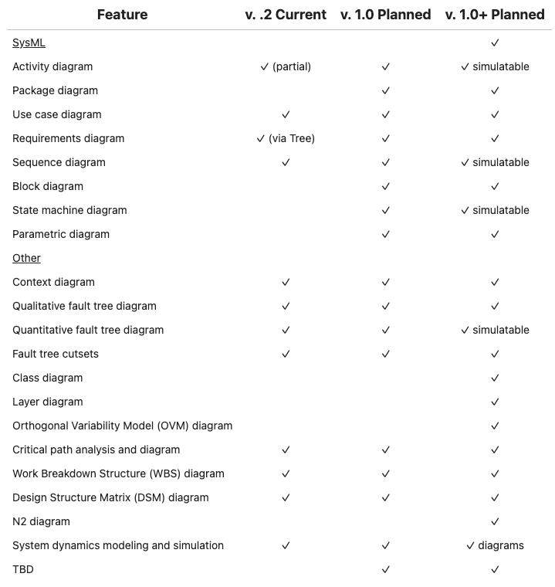
Feature Plans
V 1.0 release plan is to cover all SysML
Notes:
https://sysml.org/tutorials/sysml-diagram-tutorial/

Slide 10
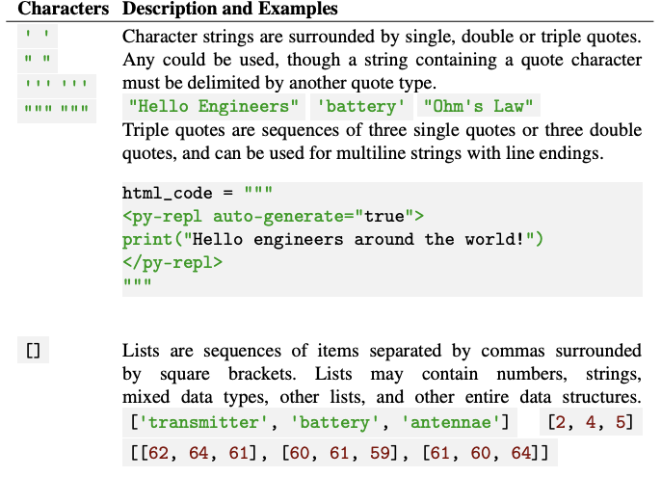
Introductory Python Syntax

Slide 11
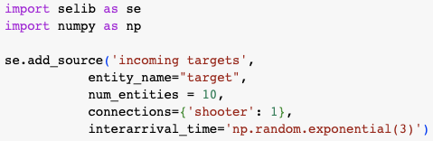
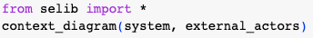
Importing se-lib
The keyword import imports a module into the current namespace and makes available its contained functions and classes:
Recommended convention is to rename selib to “se” namespace as typically done with popular Python packages:
Similarly, from imports a specific module or object from a module
For conciseness and simplicity, this tutorial also shows functions calls with no selib prefix when importing all functions this way:

Slide 12
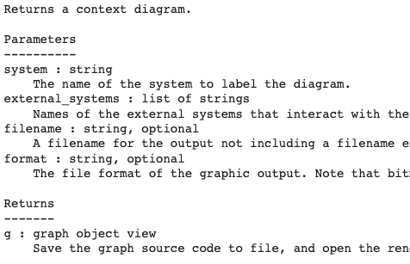
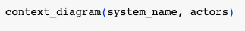
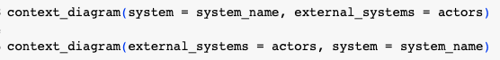
Function Call Options
API
Function call prefix options depend on import usage.
Can provide function inputs with or without argument keywords.
Must be in correct order with no keywords
When using keywords the order doesn’t matter
Many functions have optional arguments.

Slide 13
Function Call Syntax
Some inputs are tuples which are similar to lists but enclosed in parentheses.
Lists vs. Tuples in se-lib function calls
Lists are used for generalized data structures of variable length. E.g., indeterminate number of unordered use cases:
Tuples used for inputs with fixed number of elements where the order matters. E.g., (actor, use case) for each use case interaction:
(element name, icon) for each actor:
Can avoid above considerations by modifying provided examples.

Slide 14
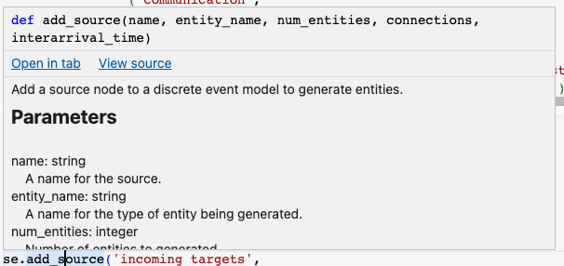
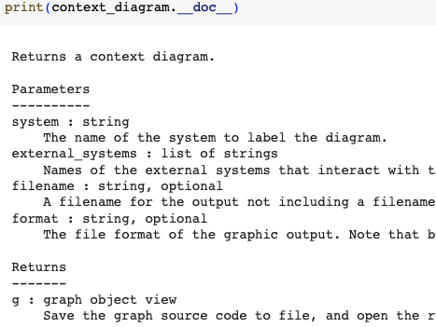
Help
See the API Function Reference for full documentation on the se-lib function calls.
Can use the Python __doc__ method to get documentation for any function:
Context sensitive help in tools when hovering over function statement:
Online playground pages and notebooks contain help:
http://se-lib.org/online/discrete_event_modeling_demo.html
se-lib system dynamics examples on Google Colab

Slide 15
Examples

Slide 16
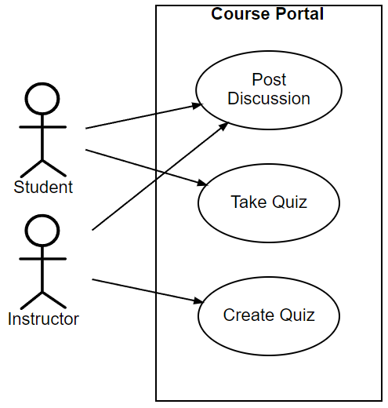
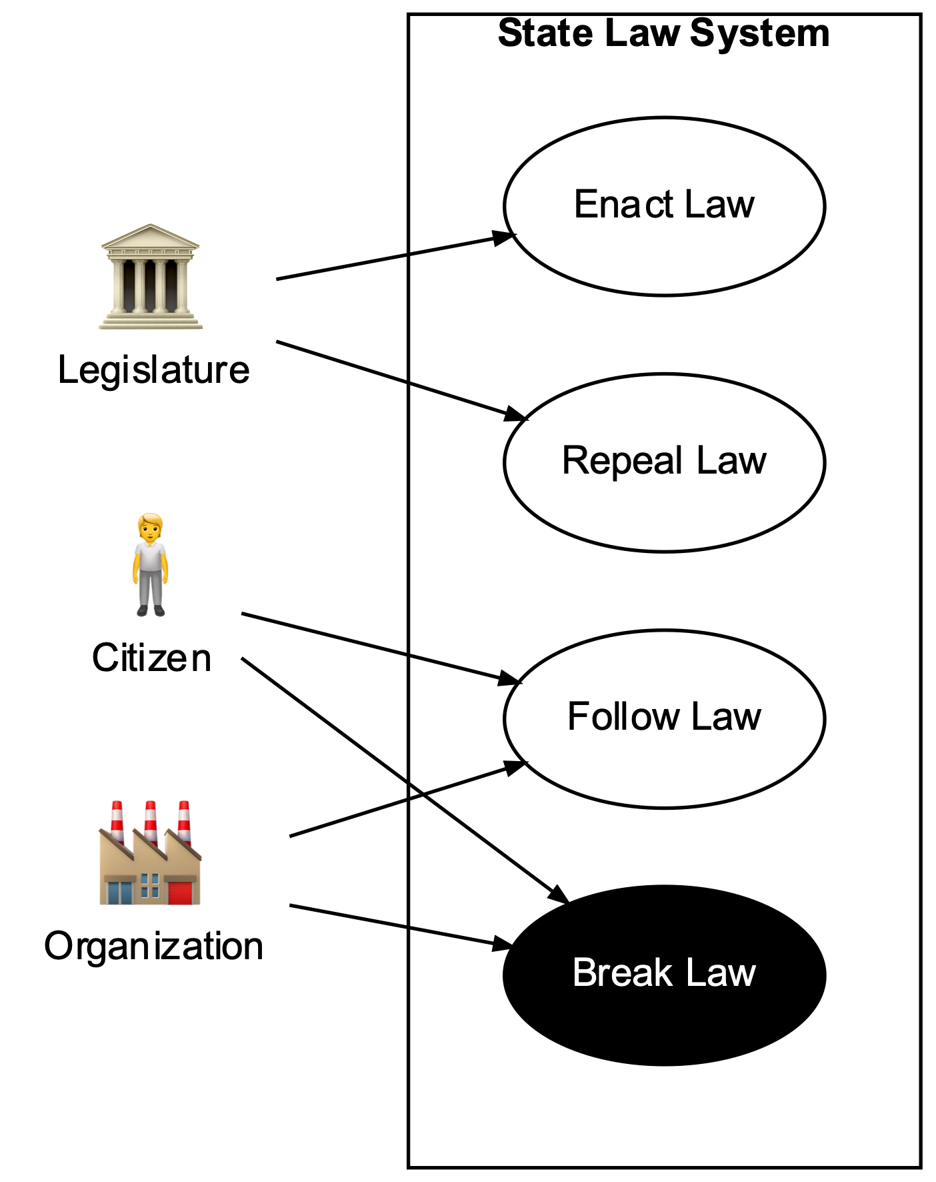
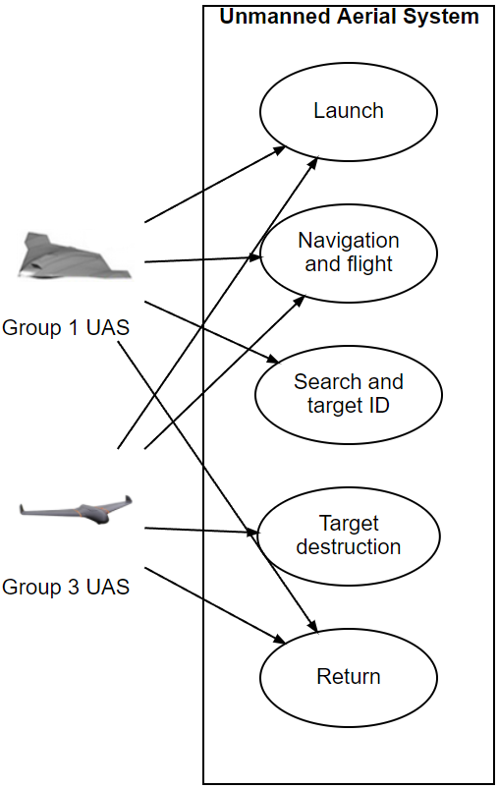
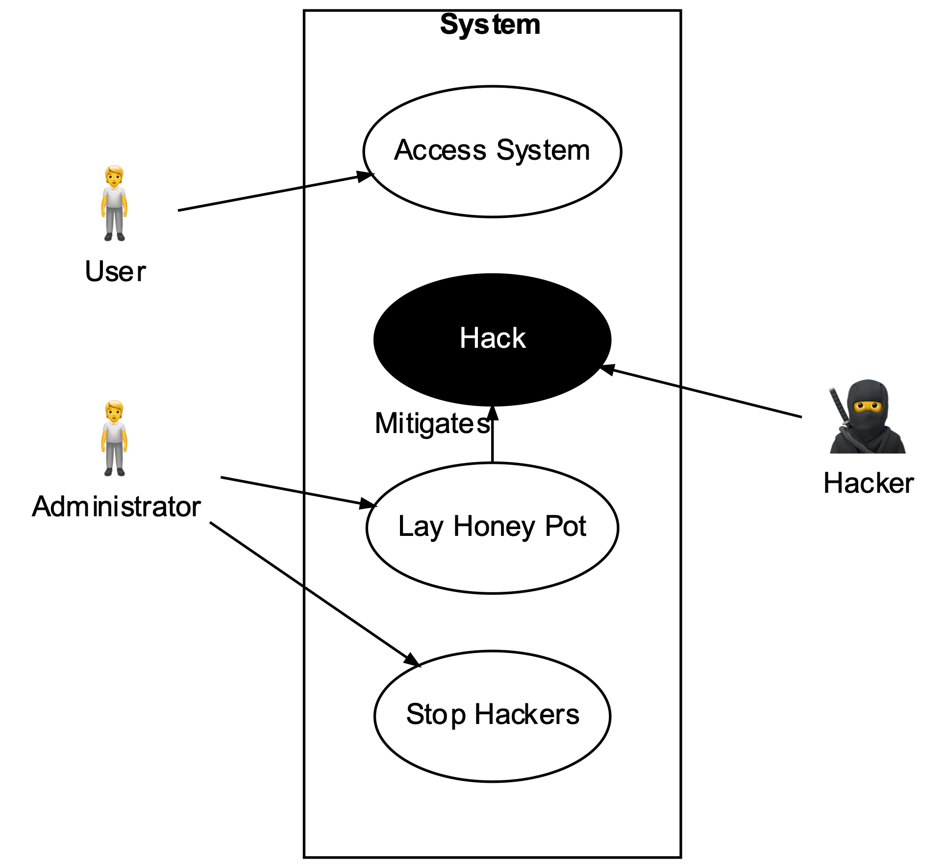
Use Case Diagram Examples
Notes:
Update law system
Show code?

Slide 17
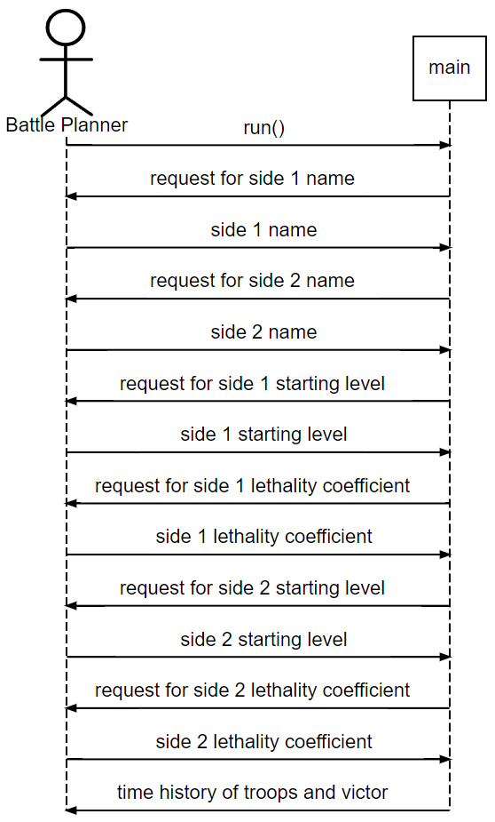
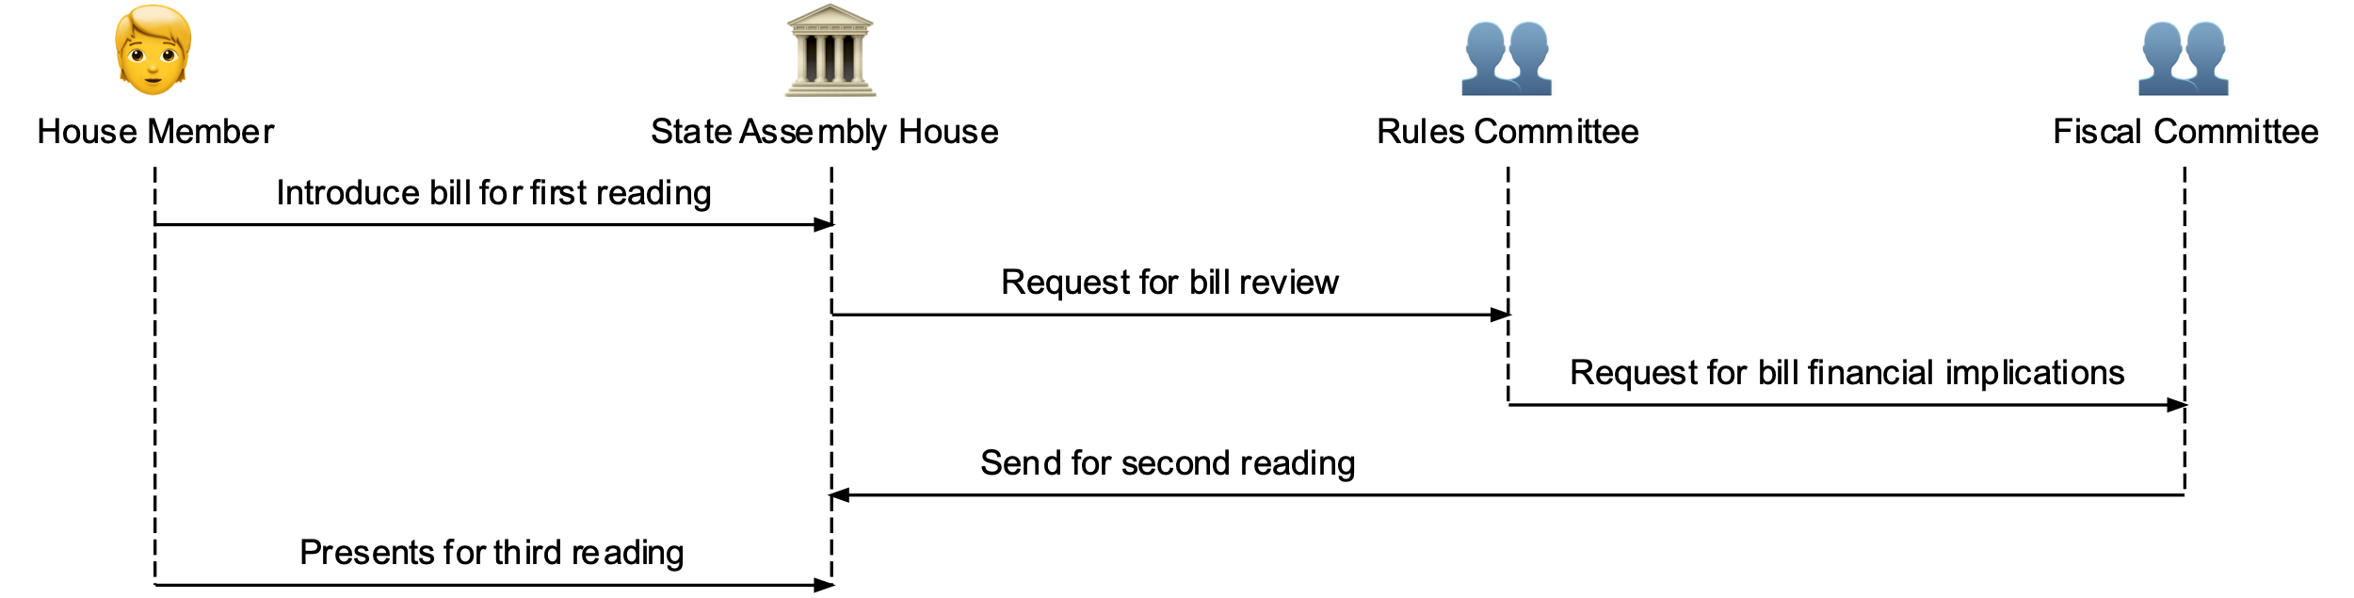
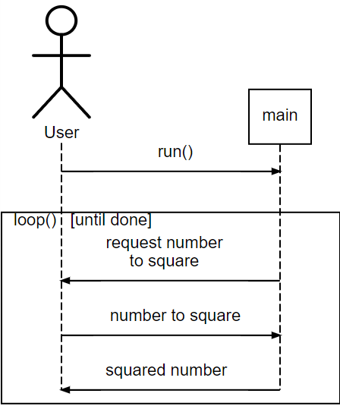
Sequence Modeling Examples
Notes:
Make battle simulator M-C
More examples 3 actors

Slide 18
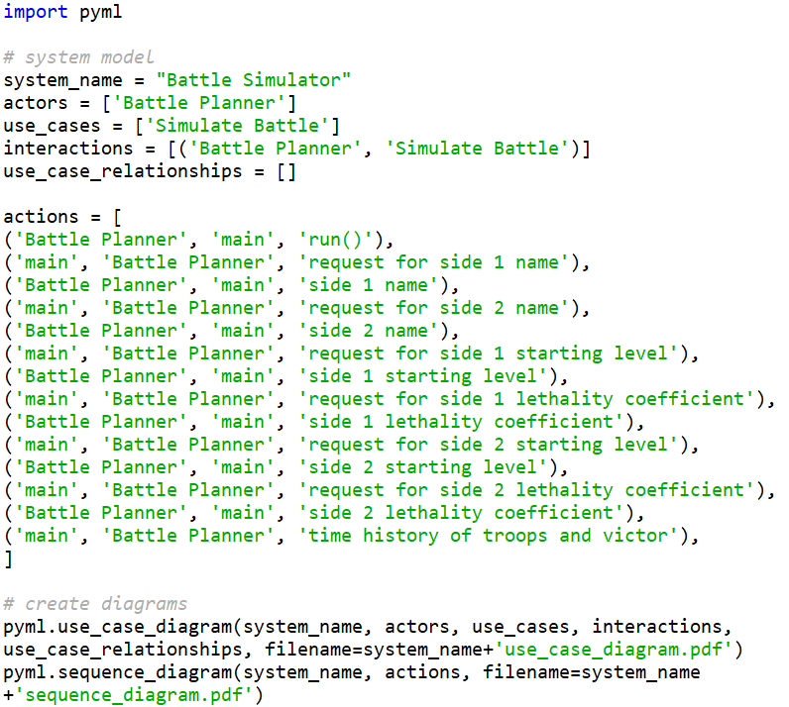
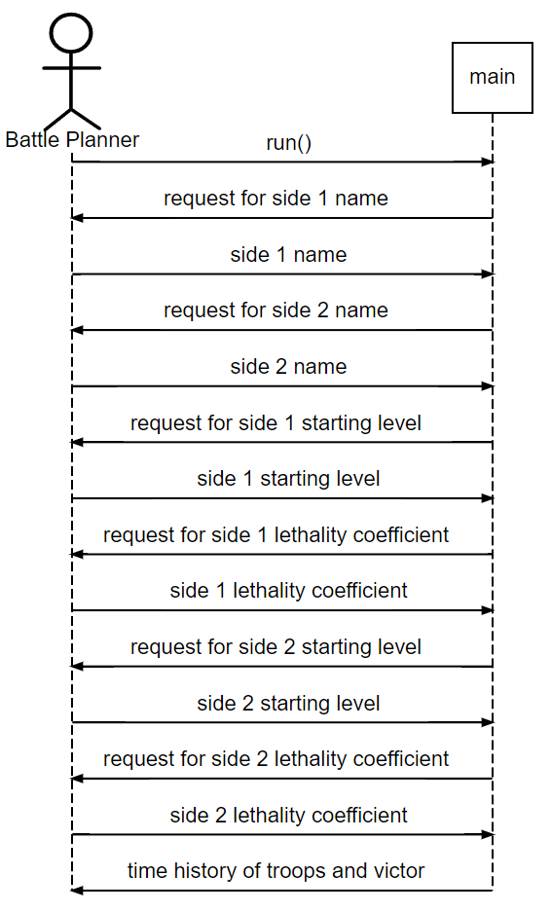
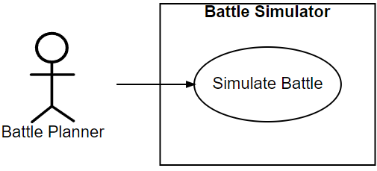
Battle Simulator Inline Model Example
Input
Output

Slide 19
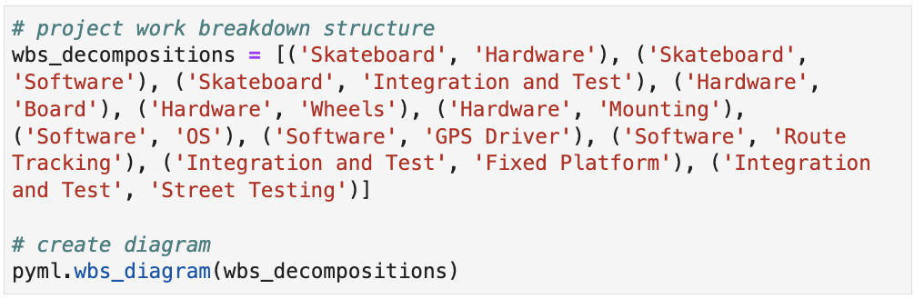
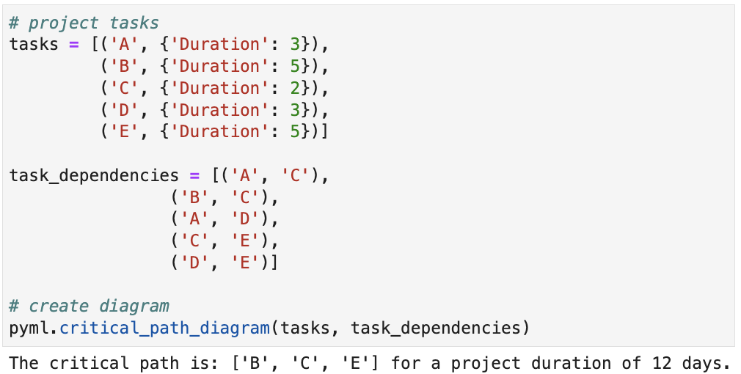
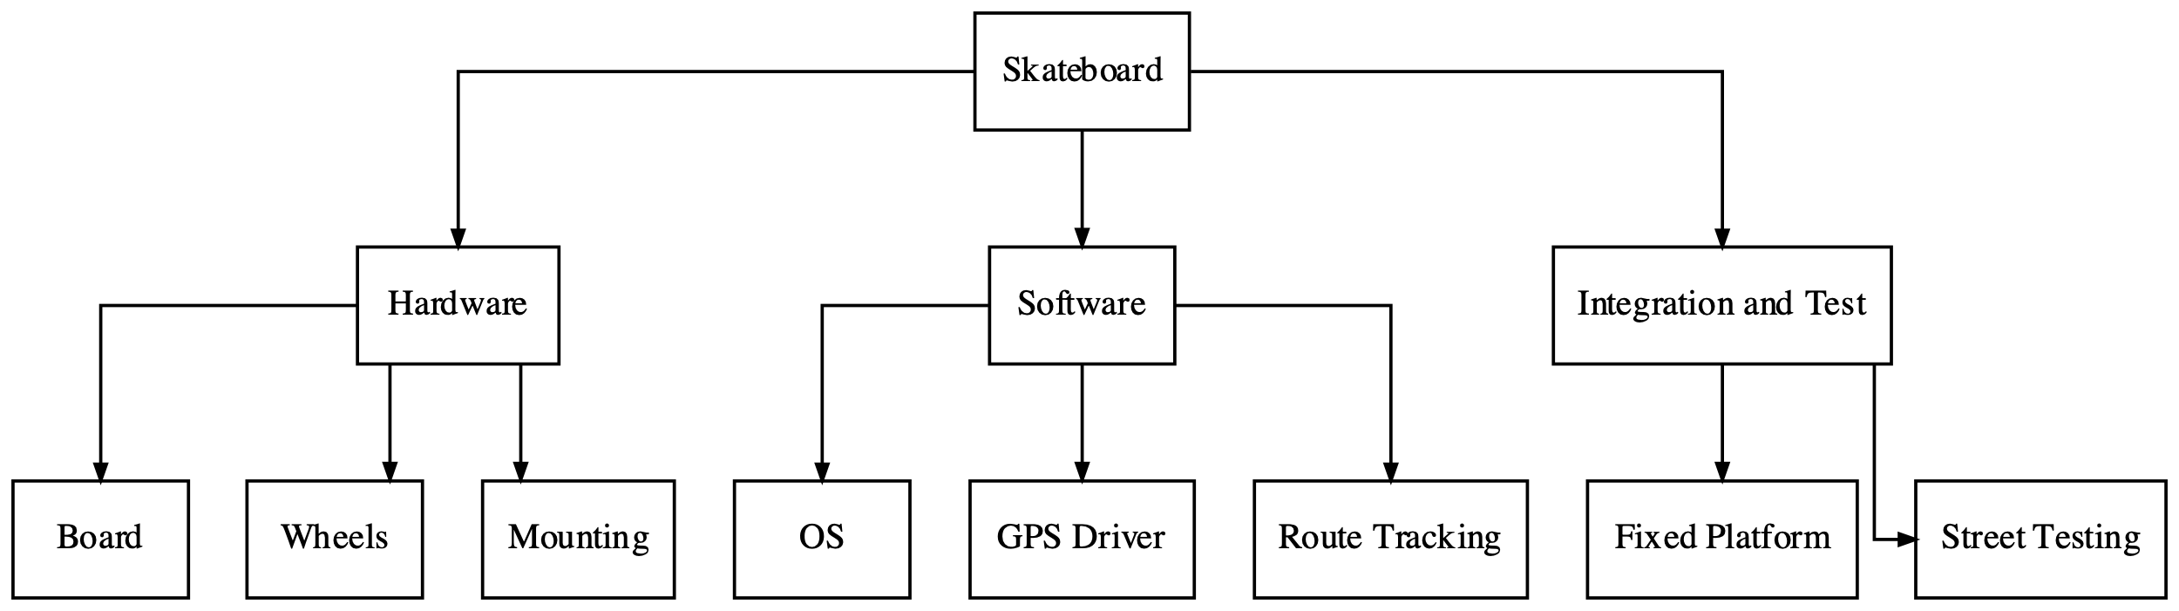
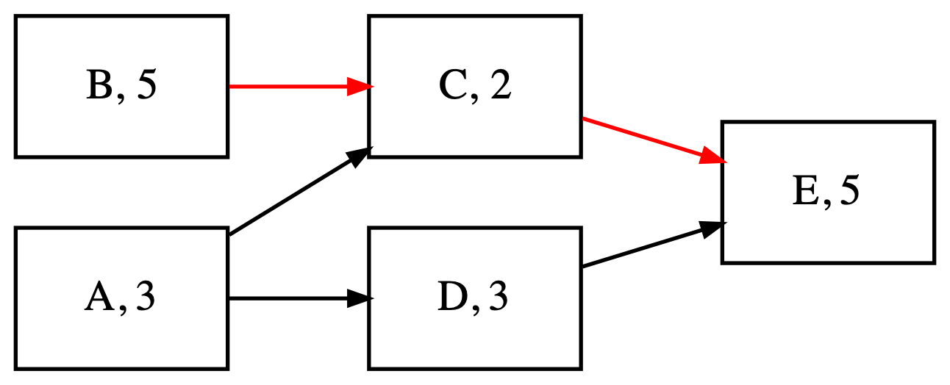
Project Management Modeling (1/2)

Slide 20
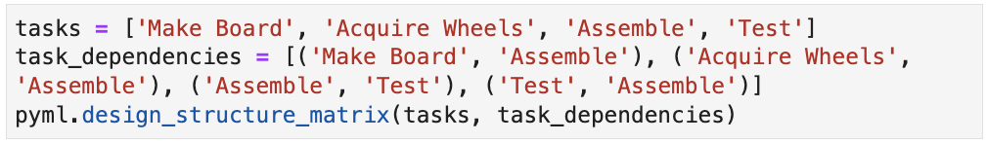
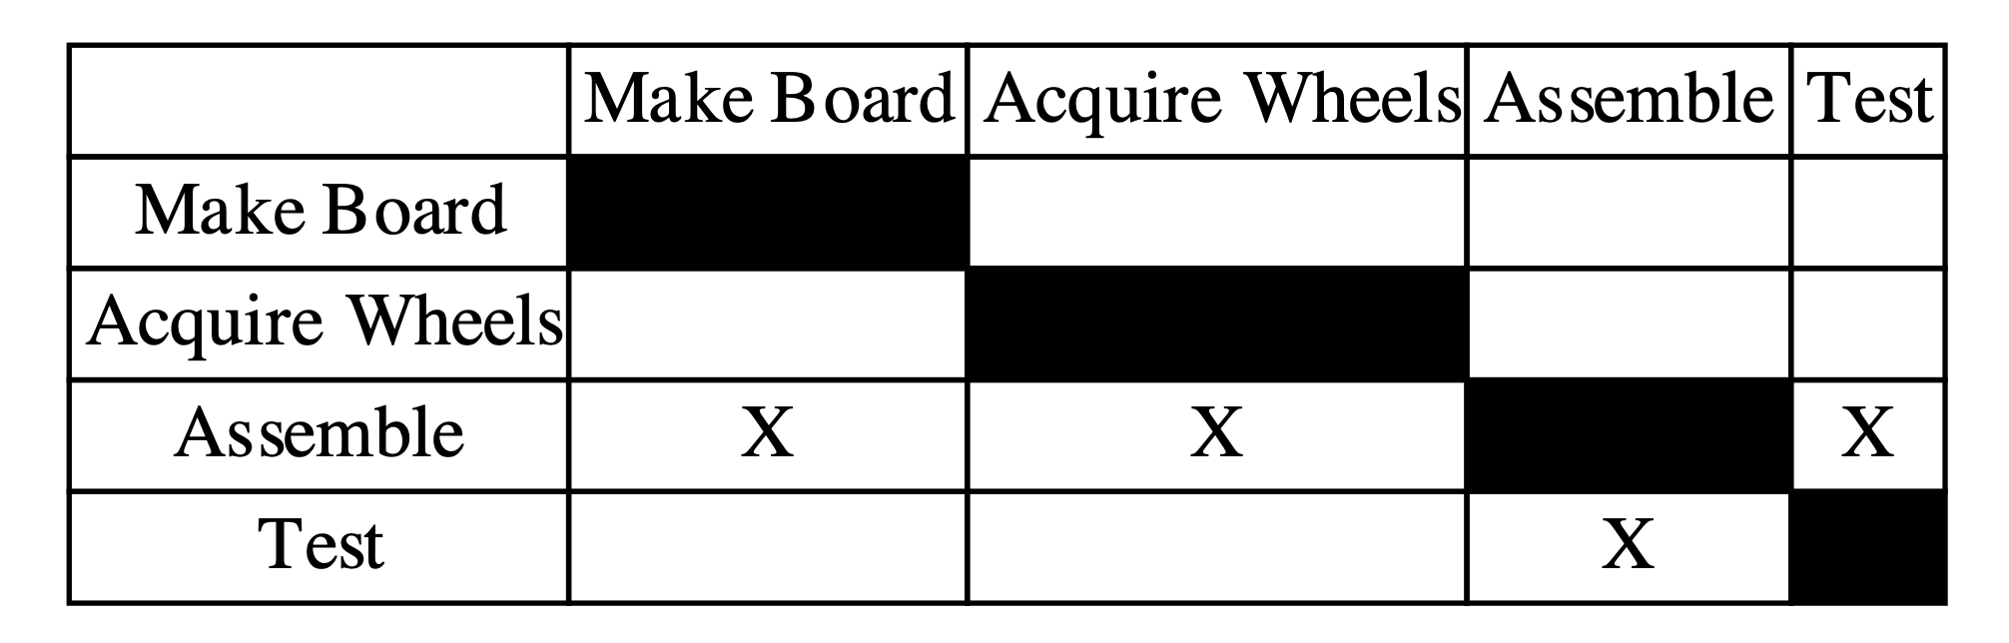
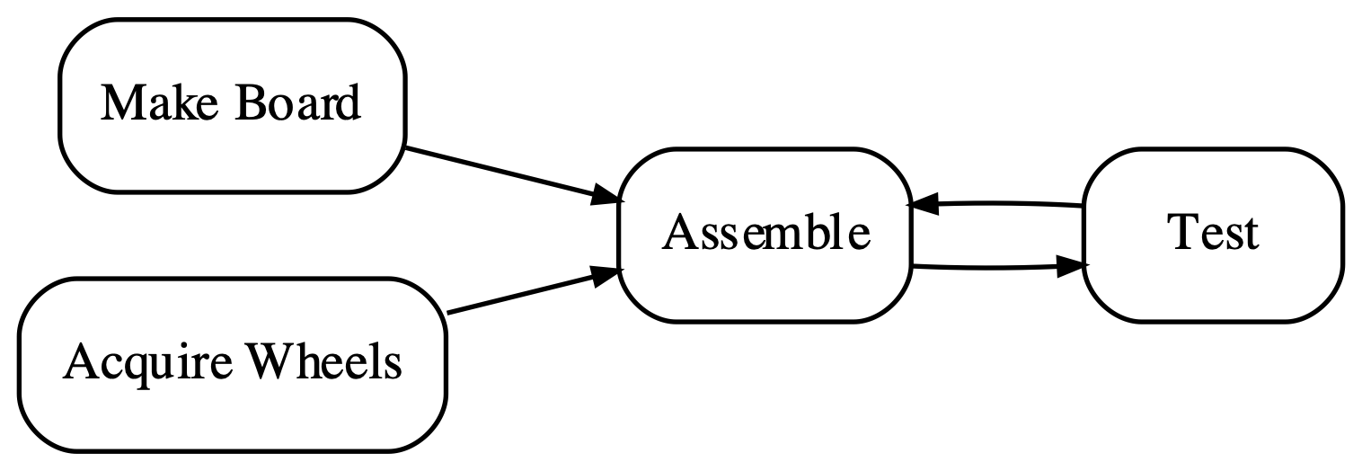
Project Management Modeling (2/2)

Slide 21
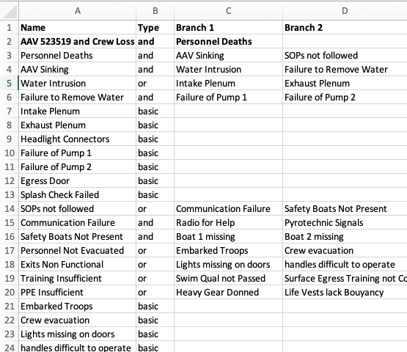
AAV Disaster Fault Tree from Excel
…
Notes:
June 5 10:08

Slide 22
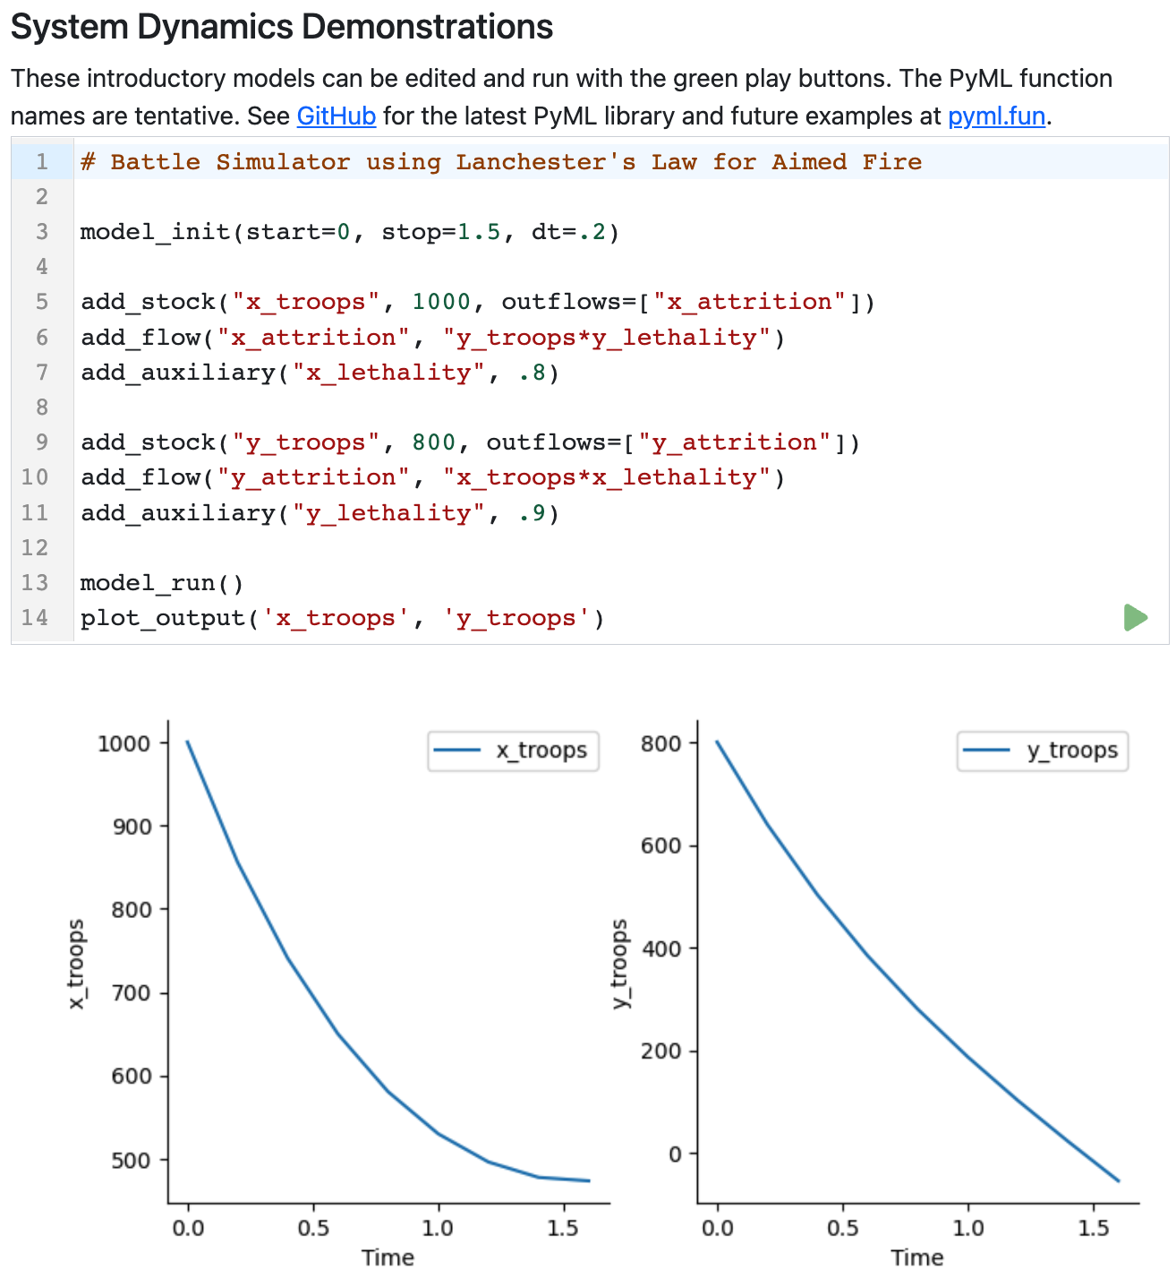
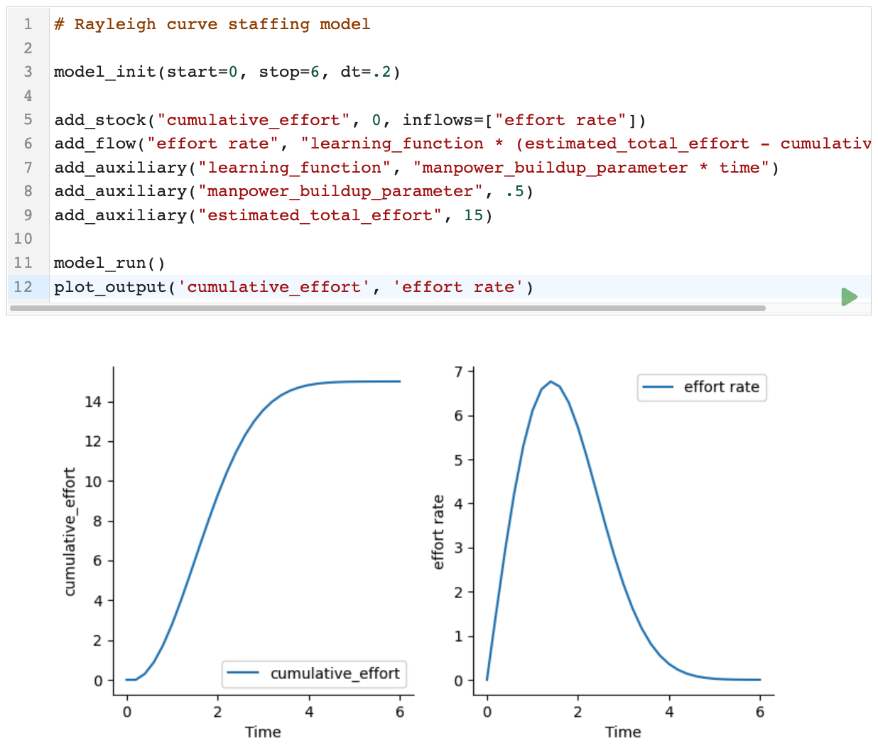
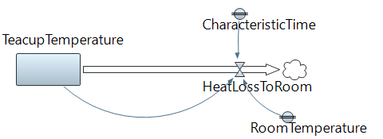
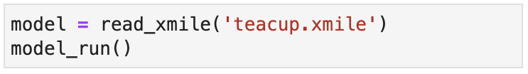
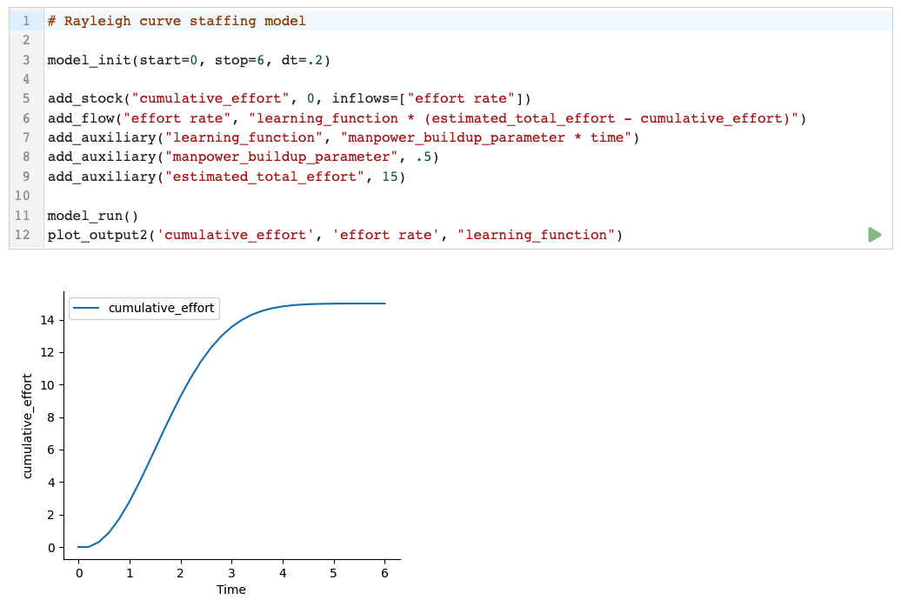
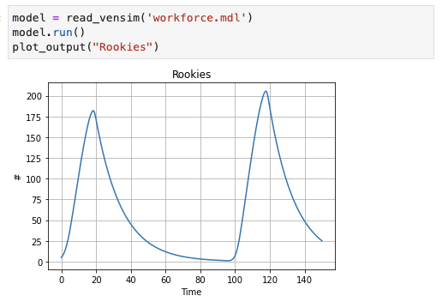
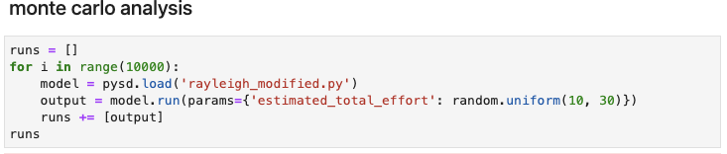
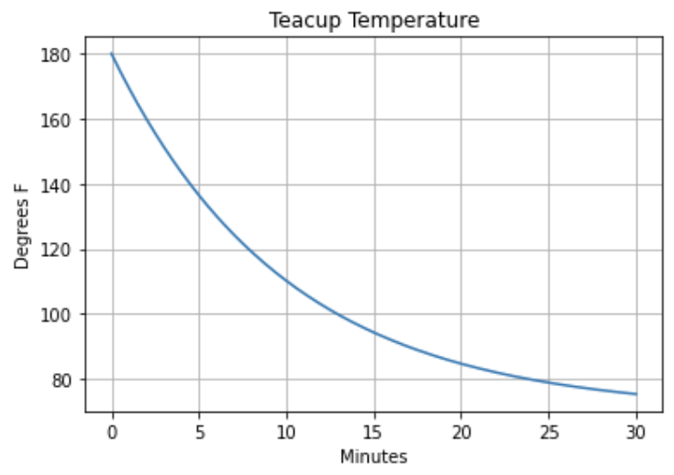
System Dynamics Modeling and Simulation
Functions provide high level interface for model composition and execution with PySD model reader and simulation engine.
Interoperable with Vensim, iThink/Stella and AnyLogic with xmile model format.
More examples, Monte Carlo simulation

Slide 23
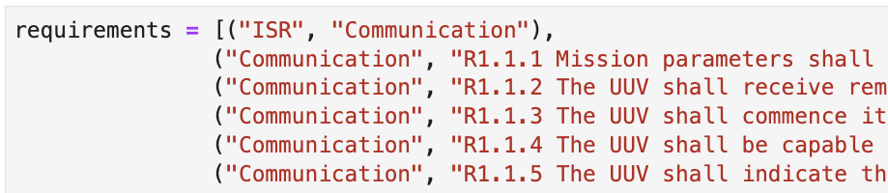
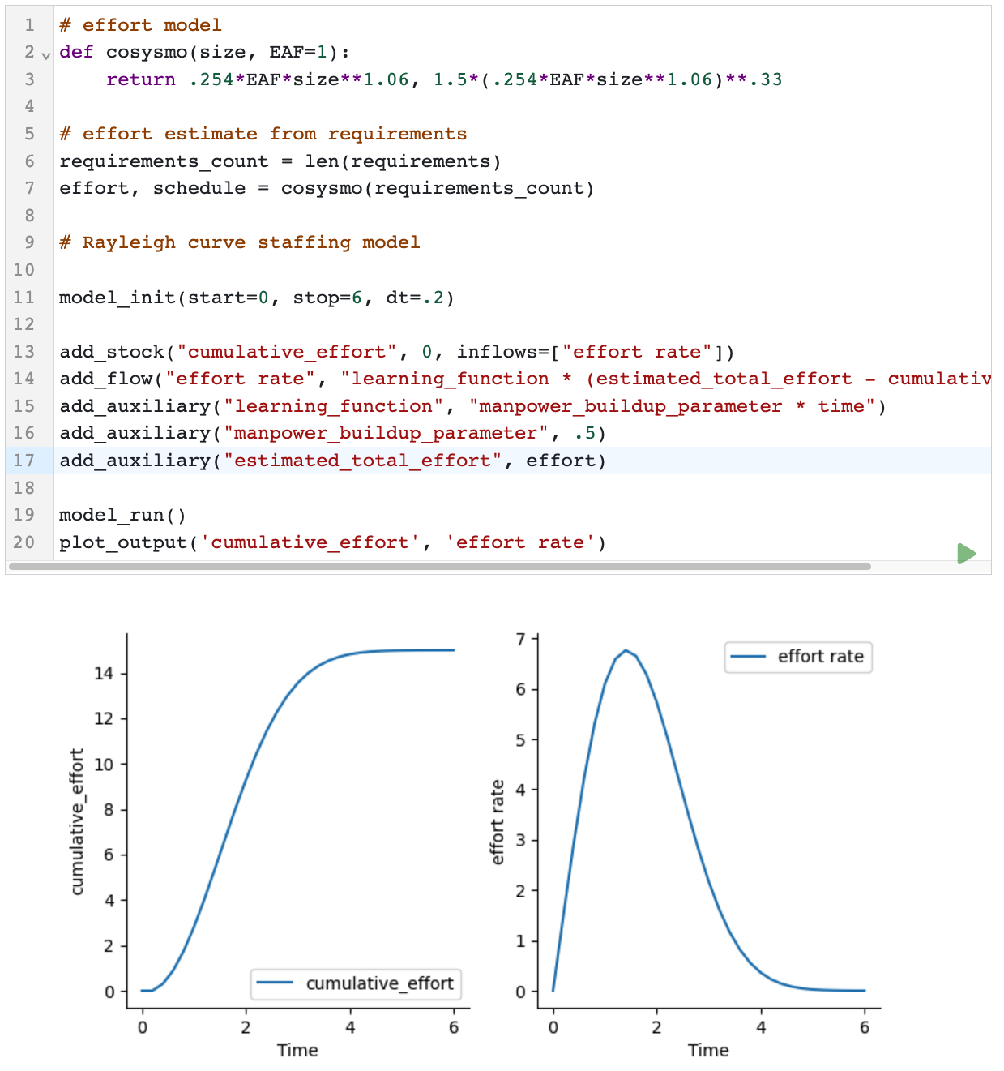
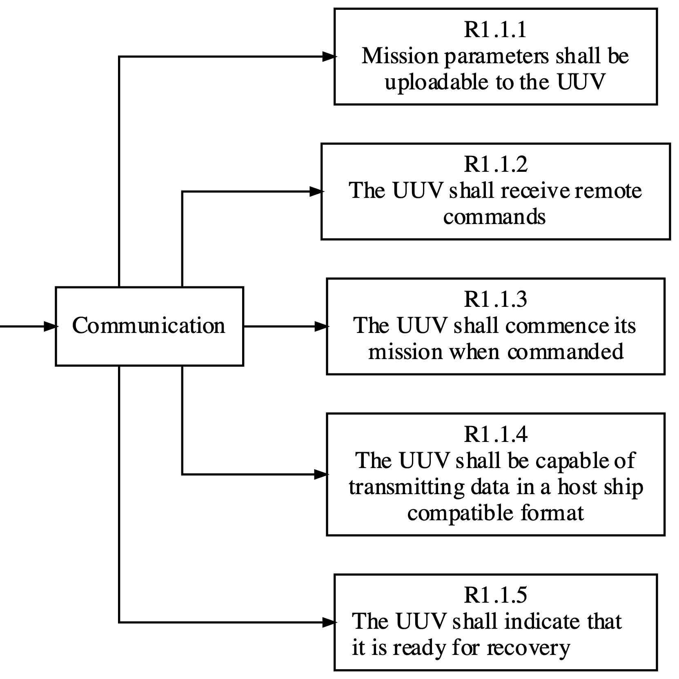
Integrated Requirements and Effort Models
…
…
Notes:
Same requirements data for rqts. tree visualization, input to parametric COSYSMO for effort, and SD Rayleigh curve staffing model for project planning
Rqts trees, show github diff commit, new staffing rayleigh curves
https://www.koombea.com/blog/staffing-model/
A staffing model consists of reports and business data that measure and describe how your employees work, current staffing needs, and labor costs in both time and money. Staffing models are also called staffing plans by some organizations. Typically, these terms are used interchangeably.

Slide 24
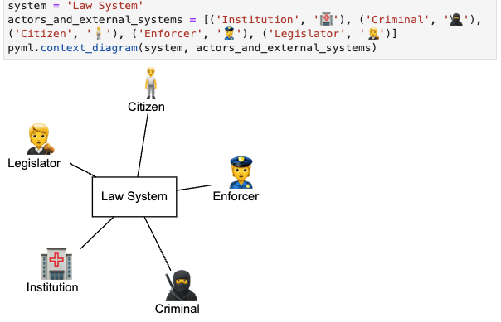
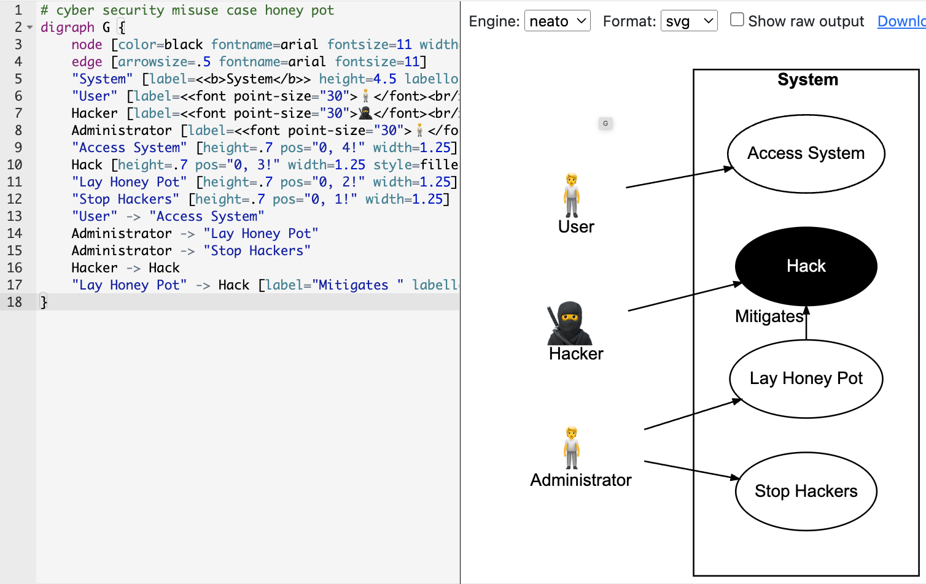
Customization and Shortcuts
Styling
Custom icons with unicode
APIs support color options, formatting, word wrap size, and more.
Shortcuts
Use tuples for node fan-in and fan-out connections to alleviate redundancy
Graphviz online tool enables customization of dot markup at http://pyml.fun/graphviz_online
Notes:
https://tinyurl.com/yx39wax6
Must fix the example with neato by default
Can replace many statements with one via tuple of node connections

Slide 25
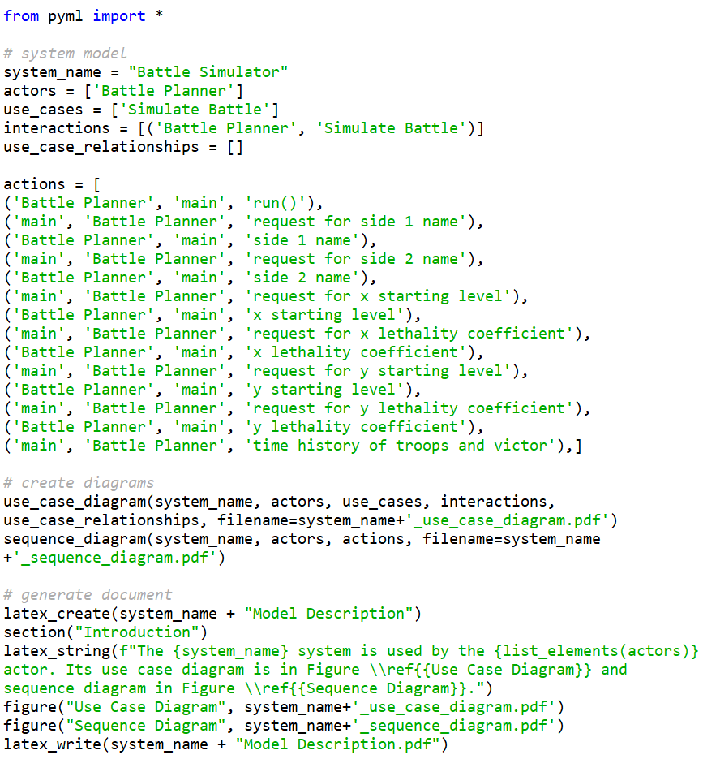
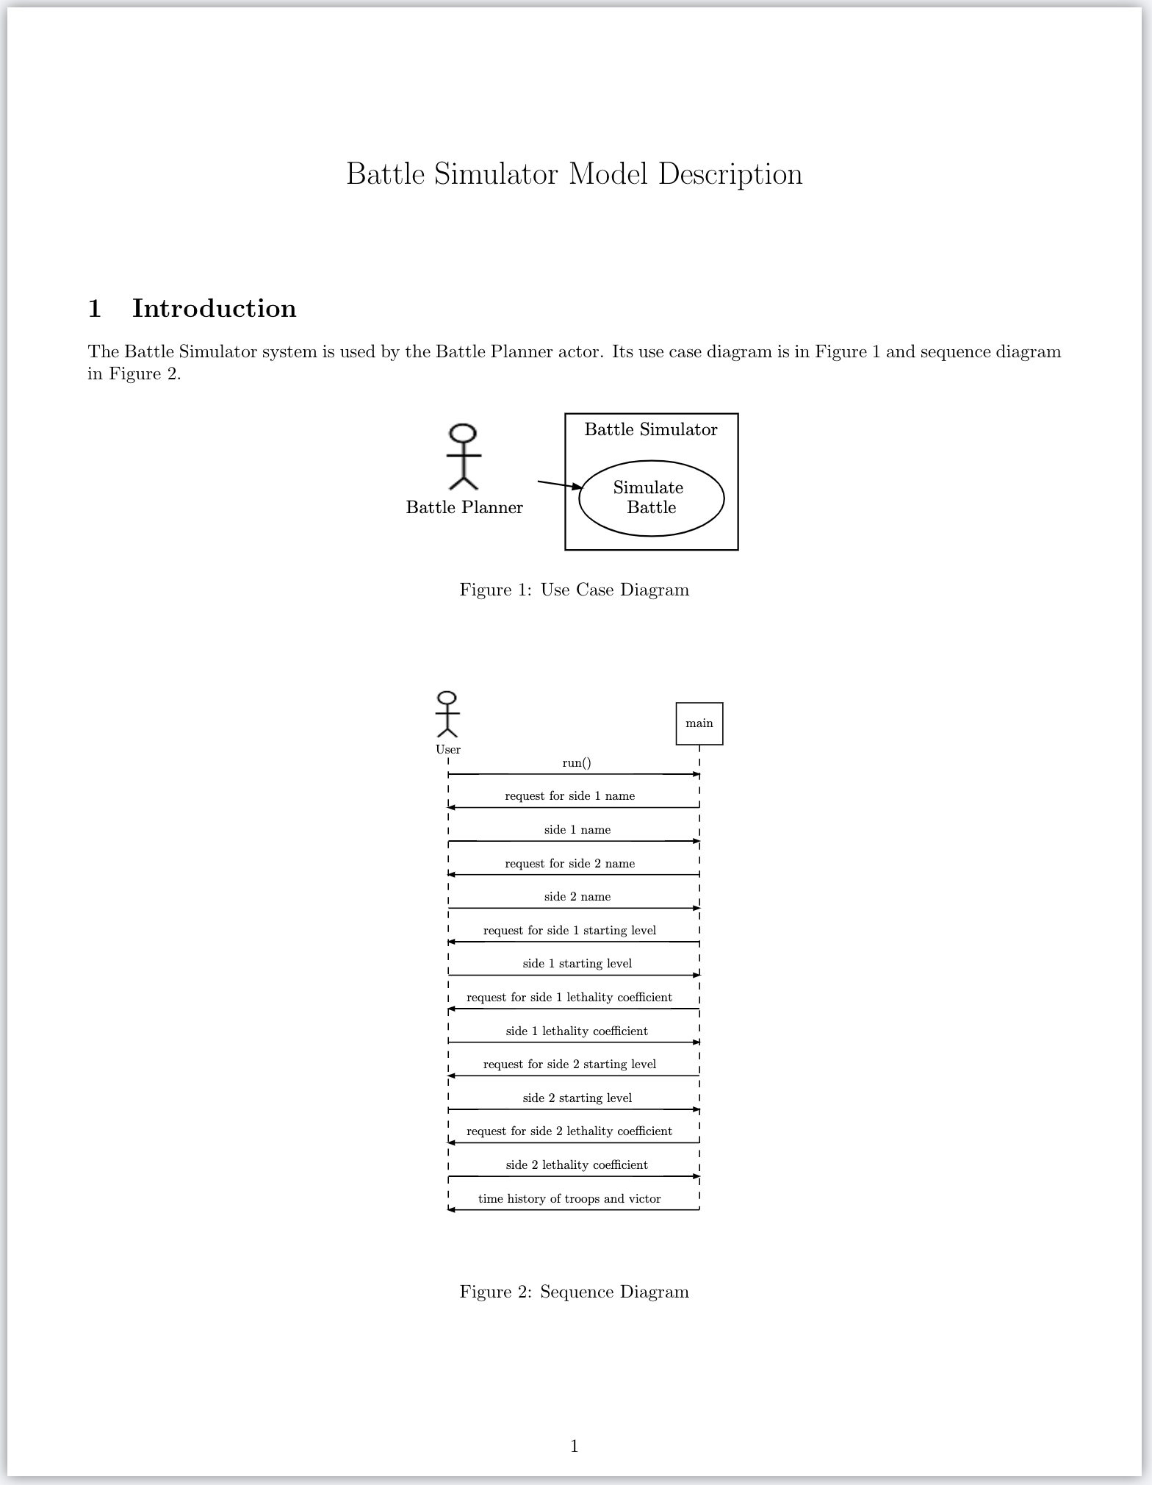


Example Document Generation Including Diagrams
Input
Output

Slide 26

Prototyped Upcoming Features
Activity model diagrams with more node types
State model diagrams
Orthogonal variability model diagrams
Dynamic fault tree simulation
Notes:
Hyperlink dynamic fault tree

Slide 27
Future Work and Capabilities
Additional object-oriented API
Foster reuse, adoption and increase sophistication
Can alleviate manual bookkeeping across models
Graphical editor for diagrams in browser using open-source JavaScript
Natural language extensions
E.g., write concise sentences for use case scenario and sequence model interactions using simple grammar rules and keywords
Code generation from sequence and activity models
See http://se-lib.org for more information.
Notes:
Ordering of source and target in sentence, eywords like send, receive,

Slide 28
References
Systems Engineering Library (se-lib), http://se-lib.org, Accessed June 9, 2023
sysml.org, SysML Open Source Project - What is SysML? Who created SysML? https://sysml.org/, Accessed December 7, 2021
R. Giachetti. “Digital Engineering.” in SEBoK Editorial Board. 2021. The Guide to the Systems Engineering Body of Knowledge (SEBoK), v. 2.5. Hoboken, NJ: The Trustees of the Stevens Institute of Technology, https://www.sebokwiki.org/wiki/Digital_Engineering, Accessed December 7, 2021
U.S. Department of Defense CIO, DoD Open Source Software FAQ, https://dodcio.defense.gov/open-source-software-faq/, Accessed December 7, 2021
Rick Steiner, SysML Conceptual Stumbling Blocks, INCOSE San Diego Mini-Conference, January 11, 2013
Notes:
Add more

Slide 29
Backup

Slide 30
Example Modeler Scenario for Roundtrip Digital Engineering
Joe is developing a system architecture and wants to make changes for integrated models in one place with no extra manual steps to recompute analyses, regenerate all model artifacts for other stakeholders, and communicate important change impacts. PyML library functions are used in the modeling and documentation. All model data and analysis programs must be configuration controlled to adhere to a common baseline.
The distributions of some system parameters need to be revised that will affect requirements, performance and cost models. Simulations assess the system availability and reliability, perform a hazard analysis, estimate cost, and the Measures of Effectiveness (MOEs) are aggregated in a weighted criteria matrix.
He accesses the shared project repository on GitHub and updates the parameters in a main configuration file. He commits the changes back into GitHub.
He wants the changes to trigger a common script that reconciles the models, recomputes all simulations with the updated parameter values, and produces an updated set of documents online for other stakeholders. All affected visualizations need to be regenerated and inserted into iterative project documents. The scripts need to call the requisite programs for analysis and documentation using the library functions with updated model data.
Errors and warning notices are to be provided for any broken or inconsistent models. E.g., a performance or cost threshold is not being met, or a previously working simulation model fails to execute properly with the new parameter values.
He wants the stakeholders who specified thresholds for affected MOEs to automatically get notice. He expects this will occur if the requirements data contains the source of each requirement.

Slide 31
DoD Business Case
Anecdotal evidence indicates the Pareto Law holds for costly MBSE vendor tools: about 90% of users use only 10% of their features.
Open source software is fully permissible and encouraged in the DoD
DoD Open Source Software FAQ:
https://dodcio.defense.gov/open-source-software-faq/

